Slide 1
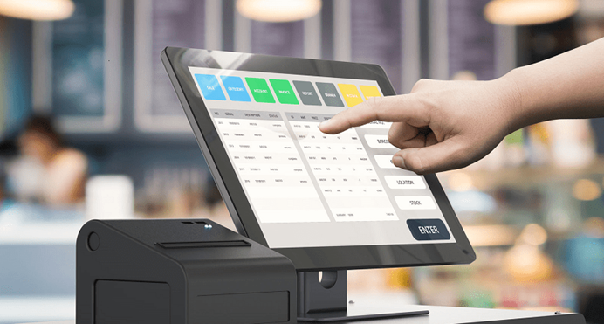

Project Documentation
Point-of-Sale Solution For Fresh Super Market
Asela Niroshan Dharmadasa,
ATN Campus.
LC000206000001
ATN-CN-T01-20102

Slide 2
Acknowledgement
In completing Fresh Super market Point of sale Solution, I had to seek for help and guidelines from a respected person, who deserve my greatest appreciation and gratitude. The completion of this project gives me much pleasure. First of all, I would like to offer my biggest gratitude to my lecturer, who teach me and guide me in the System Analysis and Design subject Eng. DB Wijesinghe, for giving me a good guideline and countless consultations.

Slide 3
Executive Summary
This Point-of-Sale Solution has developed for a small range supermarket to perform their Point of Sales Operations.
The system supplies Inventory Management system, Consumers and Suppliers Management System with Multi User Experience in Networked Environment.

Slide 4
Motivation
Point of sales operations of the ‘Fresh Super market’ organization is not handled properly.
They are using an excel sheets to maintain Sales related information. Therefore, they need a new system which can handle all the Point of sales operations related tasks to do in lest time and lest effort.
Needed to give a Experience with Some of the features including display Sales reports according to any given month and year, top selling product items, and keeping track of all the point of sales operations details, simple inventory management.
By developing software which can handle these tasks can make it easy to keep track of information in a centralized system. In the current system there is not a proper way to identifying POS related information for customers according to the month, year separately.
Using Proper System I believed, They can increase their productivity in store and it will leads to increase their profit and reputation

Slide 5
Background / Literature Review
Fresh Super Market use manual systems to perform their sales and inventory. When customer selects their buying items to a cart, he can check out at the cashier.
Cashier creates a bill after checking the items, quantity and their price manually. Then calculate the total with calculator and issues a bill with mentioning total due paid amount. Then customer paid the amount and cashier has to check whether is there any balance to pay to the customer back is.
They ware using Microsoft excel and Manual Book keeping Methods to handle their daily operations.
So, Cashier, manager or owner hasn’t any idea about sales of the day until add the total bill amounts of the day.
And until then they haven’t any idea about amount of money they have in the cashier. So, they have to do lot of manual calculations to identify daily sales as well as weekly monthly and annually.
If consumer asks about certain product, any one hasn’t idea about availability of the product, how many amounts of product is still their inventory. So, they have to go physically or search on books and check whether item is available or not. And also, if the item unavailable they have to check the books for find details of the supplier.
After applying Software solution expected to automate lot of process and procedures and improves and enhanced the productivity of the entire Supermarket. Issuing bills and receipt via proposed system, Real time inventory and supplier management system are expected to implement.
So, at first this Point-of-sale solution is developed for a small range Supermarket called Fresh Super market to automate their Point-of-sale records and analyze their business easily.

Slide 6
What is a Point of Sale Solution
A Point-of-sale System used to perform Point of sales operations and other supportive task. And it will improve the productivity of an organization. So Usual Point of sale Systems Performs
Ordinary Point of sales Operations
Assign and update product price
Declare discounts
Inventory Operations (usually simple operations only)
Billing and reporting
User Handling (Cashiers, Mangers, Admins)
Point of Sale in the sense of "Sale product and get Paid" plays a major role in a company for several reasons.

Slide 7
Why Need a Point of Sale Solution
From an accounting perspective,
POS is crucial because POS operations and its relative operations are considerably affecting the net income of a Supermarket.
Owners must obey to laws and regulations regarding consumer rights.
From a Consumer Satisfaction and Human Resource viewpoint
consumers are sensitive to price of a product and quality as well.
products must be sell or remove from sale before their Expire date.
And helping Higher level employees to get an idea regarding bestselling items and each items enough for how many days will be an advantage.
When increase the count of consumer in same time, Company must have a system to not let them late to leave after they bought required items. In Currently lot of people consider that “Time is Money”. So, nobody likes to be late. Therefore, Super market must have a proper plan to, how let to do shopping and how to manage them without late. POS System Can act a major role for this incident, because it has a capability to reduce the time to check out.

Slide 8
Point Of Sales Solutions available in the Market

Slide 9
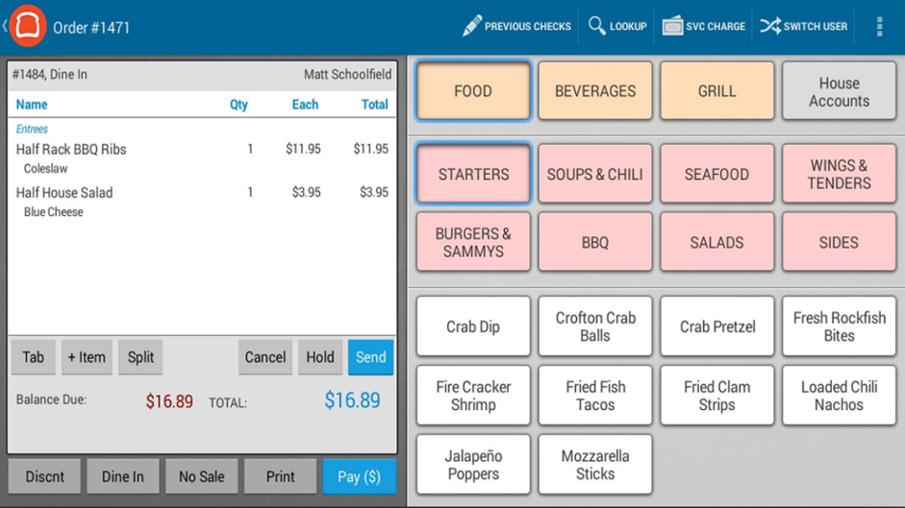
Toast POS
Toast POS was developed by Toast, Inc.,
a cloud-based.
designed for restaurant operations today. This software is designed to assist guests, employees, and managers in the food and beverage industry.
Users can access the mobile POS system anywhere and anytime, as long as there is an internet connection.
Supports online ordering, staff reporting and sales, and gift cards and loyalty programs.

Slide 10
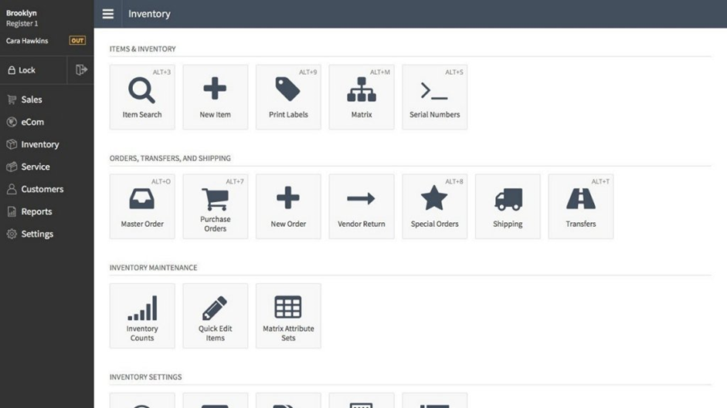
Lightspeed
Four main products:
Lightspeed Retail POS
Lightspeed eCommerce
Lightspeed Restaurant POS
Lightspeed Onsite
With this, users can choose a cloud-based solution that has features tailored to their specific business needs depending on their industry.

Slide 11
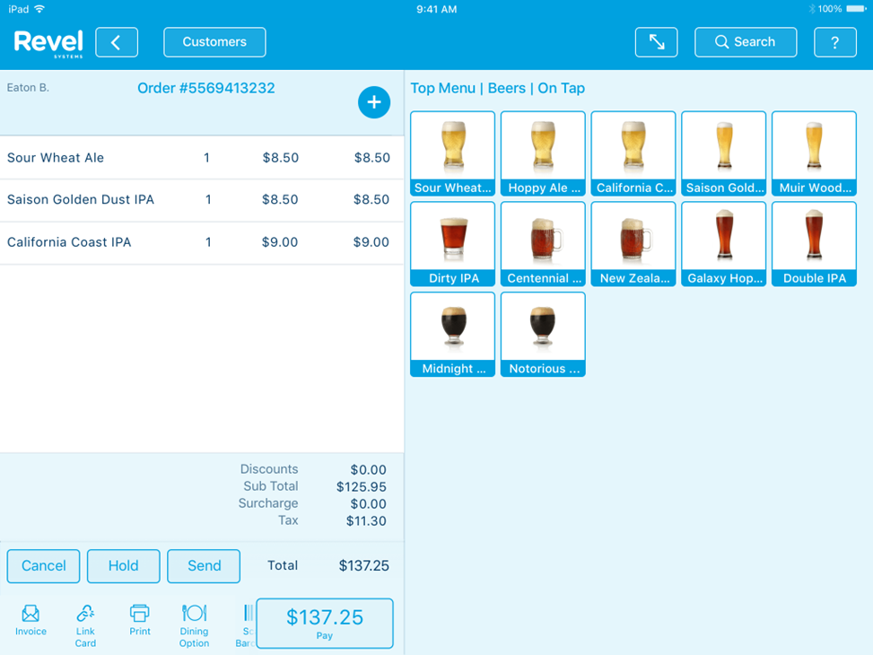
Revel Systems POS
iPad-based point-of-sale solution for merchants of all sizes,
equipped with all the functions necessary for making businesses’ day-to-day operations easier and more efficient.
paired with other tools such as employee, inventory, and sales management.
It also provides helpful insights through its reporting and analytics features. This ensures that you know which items to stock the most and which are gathering dust in the corner shelf.
can use all the features for free for a period of time to see if the software matches your needs.

Slide 12
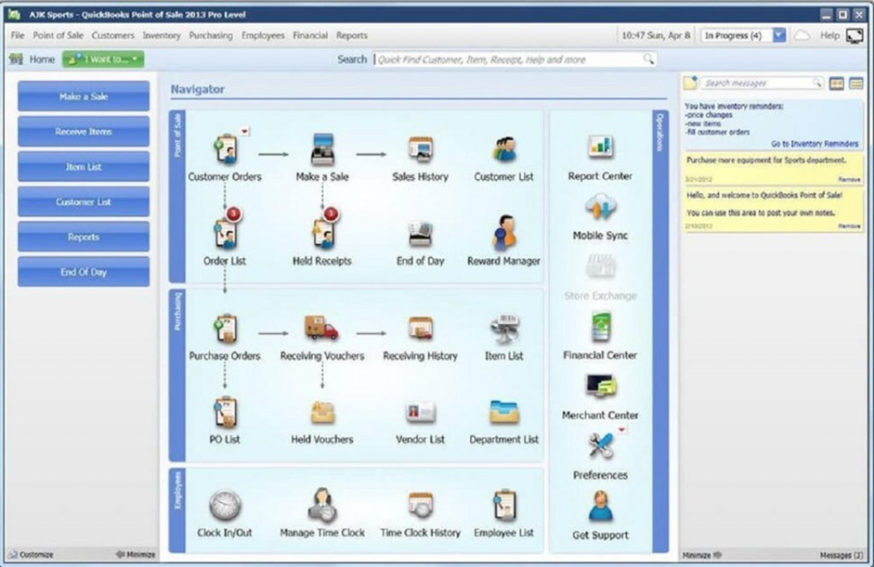
Quiсk Bооk РОS
powerful platform that enables users to track sales
customers and inventory make efficiently and quickly.
Available in two versions, Basic and Pro,
Used Most Stores cant afroed to buy custom built System

Slide 13
Proposed Soloution

Slide 14
Overall Purpose/objective of the Project
After implementation this project
Fast customer support is guaranteed
required sales assistant amount will be reduced
their workload also will be reduced.

Slide 15
Proposed Workflow
Since Customer chooses what they want, just there are few sales assistant is required for help to find out where the item located and for measurable products.
When Customer select products which they want and they can come to cashier.
Since All Products details are entered to the system cashier can identify the products which customer bought by
scanning Barcode labeled on the Item
Searching Product ID
Searching item name
No need to ask the price from managers or find in books or manual calculation because implemented system will be doing that and generate a bill.
when certain cashier off the duty they can get a summary of sales and how many cash must be at the cashier.
It’s making easy to shift changes of cashiers.
End of the day, week and month as wells as annually managers can generate report about sales products wise or category wise.
When Supplier came to the supermarket manager or owner can get inventory details filter item wise or which and which products supplier usually supply. So they can decide faster whether certain product must me buy or not.

Slide 16
Requirement Gathering

Slide 17
Requirement Gathering
Before the System analysis parts, it has to gather requirements.
Since POS system developed for enhanced existing procedure, better to get present situation of their super market from employees. They have a better idea about the current situation and may have concepts to enhanced the workflows.
So best way to collect their ideas is doing interviews with them in off peak hours of the super market. And also used a questionnaire to collect their responses will be the best way

Slide 18
Questionnaire
1. Name
2. Designation
3. Have you any IT related Experience?
4. How do your Supermarket process are handling now? (Please describe what happens, where happens, who involves, Challenges During the Process)
a. Selects items by Customers
b. Billing
c. Inventory Management
d. Purchasing
e. Shift Changes Cashiers
f. Supplier Management
g. Reporting
5. Any Idea to enhance above process as You think?
6. Usually How many Customers in the supermarket at a time?
7. Usually How many Customers in the supermarket at its busiest time?
8. Usually how many Customers came to the supermarket in a Day?
9. How many minutes take to prepare a bill and accept cash?
10. How many minutes spent at the queue by customer usually and busiest time?
11. Please Describe the Procedure when returning an item.
12. Please Describe the Procedure to purchase items From Supplies.

Slide 19
Requirement Analysis
Analysis is based on requirement gathering, functional requirements and non-functional requirements.
First have to gather required information from the client
It leads to have good understanding of the requirements of the users of the system.
And also required information is done by referring the internet and find out similar solutions
had meet ups with the client and by doing so able to gather lot of information like
how should be the interfaces looks like
what are the main and sub functionalities
what type of users may use the system
their computer knowledge and understanding

Slide 20
Functional Requirements
1.System must be help to items to add the bill without any delay
2.Cashier must see available quantity and prices of each item in the super markets when doing POS operations.
3.Before start the entering data, cashier must create a bill and it must be assigned to the name of customer. (Default customers must be available)
4.After adding items System must generate a printed bill.
5.System must be display selected items, quantity, each price and subtotal amount (each price * Qty) When adding items and must be shows Current total amount of the bill.

Slide 21
Functional Requirements
6.When change the Quantity after adding item system must be auto updated to the bill amount subtotal and discount.
7.When add before added items to the same bill, (customer has choose multiple items from each item) bill must not create another row, it must update previous item record by updating current quantity.
8.System must be capable to handle several bills simultaneously
9.After adding items final total must be displayed in pole display too and bill must be printed.
10.There are several types of users to perform on the system and system must configured to access functionalities according to the user privileges.
11.End of the day each user can get sale summary report and other required reports according to their privileges

Slide 22
Non – Functional Requirements
User friendliness of the Interface
User is able perform POS operations within single interface easily.
user can view all the allowed panels in a single interface.
Admin User and managers can view the reports according to the year and month in a single interface.
Interfaces are clear and easy to identify because of the look and appearance of those.
It is not used complex themes and colors and themes will be attractive for the person using the system.
Performance
User will able to view the available details quickly without any delay.
Data should be loaded instantly to the user when perform a task in the system.

Slide 23
Non – Functional Requirements
Security
System Must be password protected.
Main interface of the system can be only accessed after provide the main password.
view reports and to done a restoration of a database need separate passwords to ensures the security of the system.
Availability
System should available for the use whenever it needed to access.
Connection to the database should be there always and hence able to do any insertion or updating to the database without any issue.
Privacy
All employee related details only can be update and access by authorized person.
Database access should be only done using authorized person and database should have a password and only admin users should able to use that.

Slide 24
Requirement Analysis

Slide 25
Proposed System simple Work Flow

Slide 26
POS operations (Brief)
Customer Selects items by reaching to the item
After Selecting item customer will be at a Cashier
Cashier Create a Bill and Enters items to the Bill
System Shows Subtotal and Current bill amount when cashier add items to the system
After adding items System displays the total bill amount
After adding items, Pole display shows the final amount and Cashier says to the customer
Cashier select the payment method by asking the customer
Cashier Enter the cash amount and give back the balance amount if available or process the Card payment System.
System Generate the Bill
When Cashier Marked as Paid System will updated and ready to serve another customer

Slide 27
Create the Bill
Before start the entering data, cashier must create a bill and it must be assigned to the name of customer. (Default customers also available)
Bill has several states as follows
Created - customer came to the cashier and ready to add items
Processing - adding items
Hold - customer choosing additional products
Bill generated - bill has printed
Paid - end adding items and paid total amount
Queue - queue to the deliver to customer if requested
Sent - sent items to customer
Delivered - Delivered items
Initially System will be displays available items at the supermarket in a left side panel. Cashier can view by scrolling and select by double tapping the item to add to current bill. cashier can use also below options to add products to the bill,
i. scanning the barcode which labeled on the product
ii. entering the product barcode to the system, iii. Searching item by name or price
Cashier can see available quantity and prices of each item in the super markets.

Slide 28
Add items to the Bill
System must be display selected items, quantity, each price and subtotal amount (each price * Qty) When adding items and must be shows Current total amount of the bill.
When change the Quantity after adding item system must be auto updated to the bill amount subtotal and discount.
When add before added items to the same bill, (customer has choose multiple items from each item) bill must not create another row, it must update previous item record by updating current quantity.
System must be capable to handle another bill without completing current bill processing. (If customer decided to add more items to the bill, cashier and next customer must not wait until the current customer come. Cashier can hold the current bill and serve the next customer. When customer comes with new items cahier can resume previous billing operation).
After adding items final total must be displayed in pole display too and bill must be printed.

Slide 29
Bill Content
Supermarket name and contact details
Date and Time and Bill Number
Barcode (product id)
Item name
Quantity
Each price
Discounts
Subtotal
Total price
Discount for the total bill
Payable
Paid type & Paid amount
Balance
Return policy notice

Slide 30
Receive Items Work Flow
Supplier comes to the manager
Manager find the Supplier from the system
System Shows items which supplier usually supply and its stock limit
If manager bought items, manager can enter records and update System
System will generate an invoice.

Slide 31
Users and Roles
There are three User types and each type has to play different roles. And also, they have different facilities to manage the System.
Cashier
perform POS operations
Check Daily Operations done by him self
Check his drawer cash balance
Check each item count within store
Manager
Perform POS operations
Check daily operations of each cahier and total
Check drawer cash balance and operations for each user
Edit a bill (remove items from bill)
Check each Item Count
Update item count and its price
Declare Discounts for each product, product category and to the total bill according to bill value
Create, edit, remove cashier users
Generate Daily Monthly and Annually Sales report
Generate cashier daily Business summary
Check Popular products,
Predict sufficient days for each item by calculation daily sales and seasonal sales (December, April)
Show Warning When item count gets low
Administrator
Perform all the manager Operations
Perform Database Backup and restore
Create, edit, delete Manager Users
So, user can perform their intended task according to their privileges.

Slide 32
System Analysis and Design

Slide 33
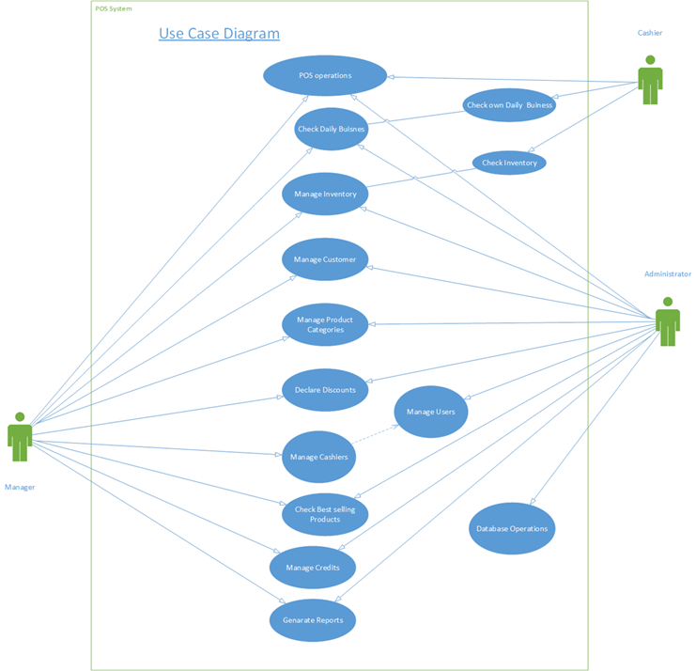
Use Case Diagram

Slide 34
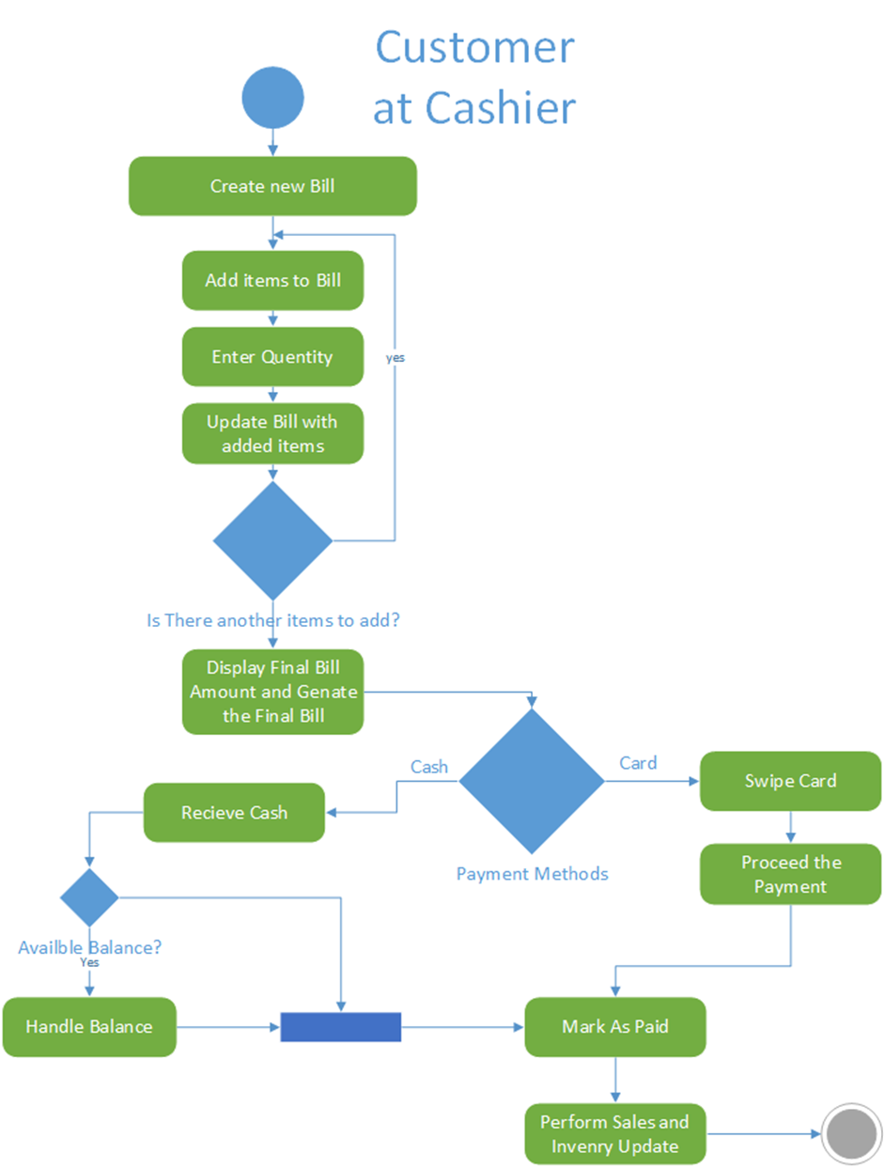
Activity Diagram

Slide 35
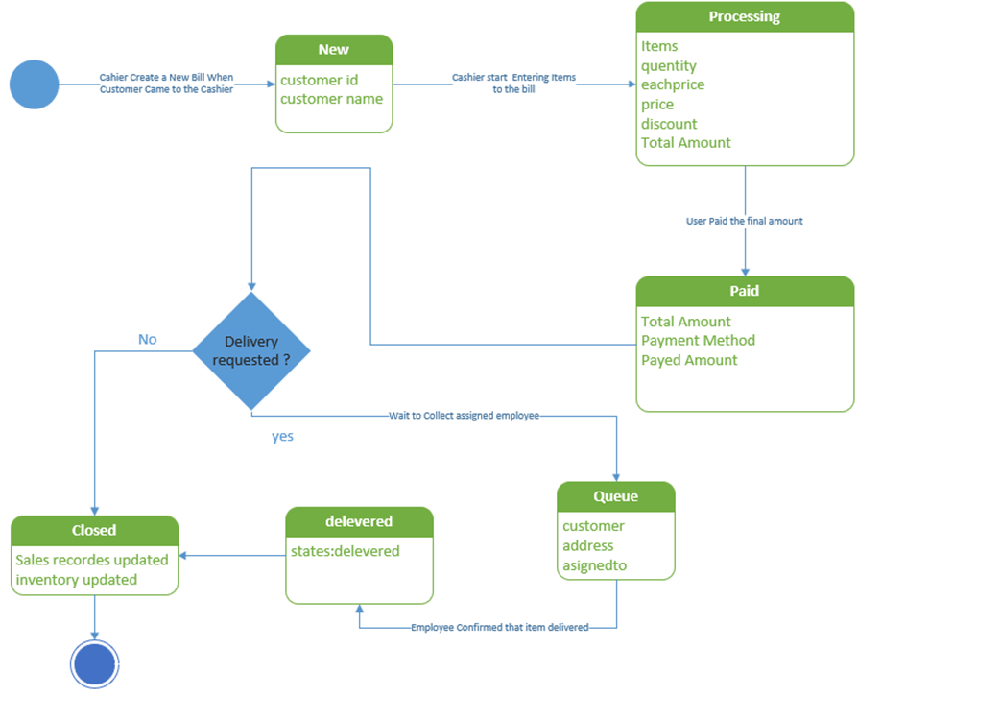
State Diagram

Slide 36
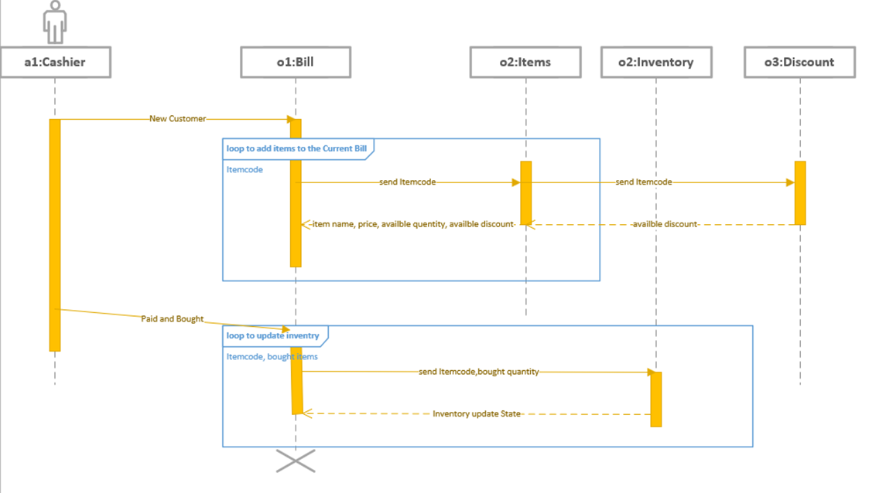
Sequence Diagram

Slide 37
Database Design

Slide 38
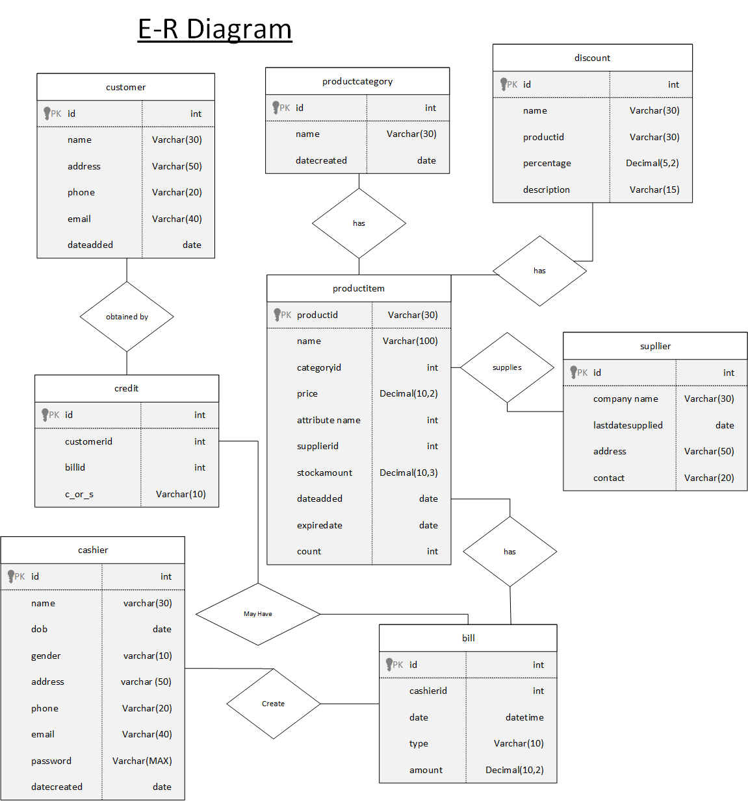
ER Diagram

Slide 39
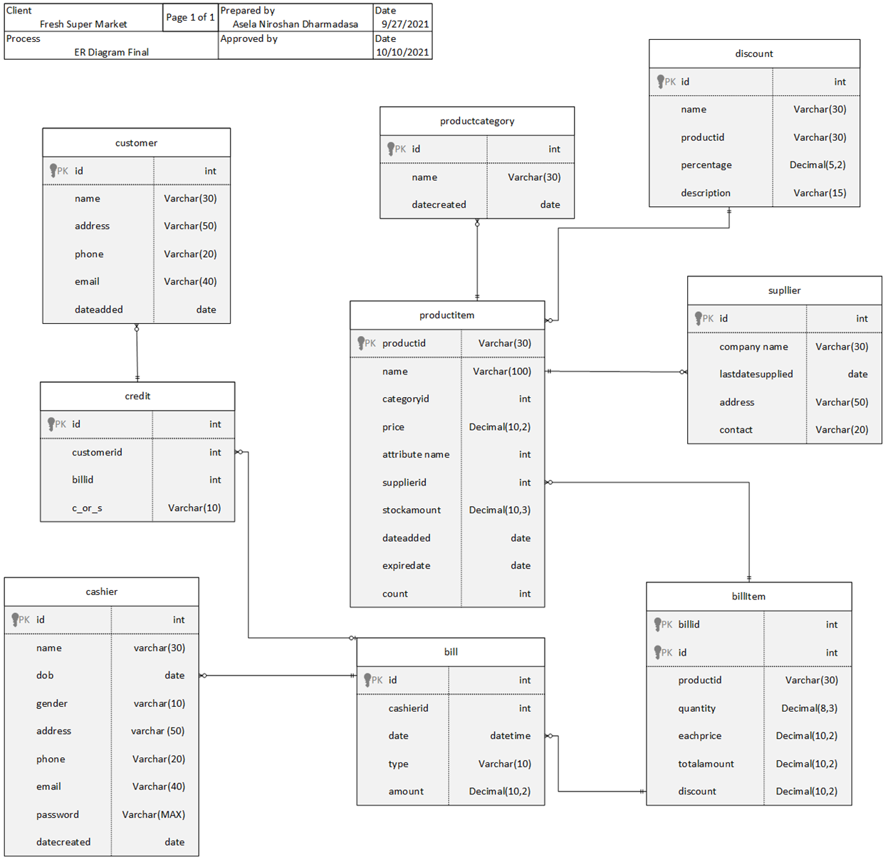
Physical Diagram

Slide 40
System Design

Slide 41
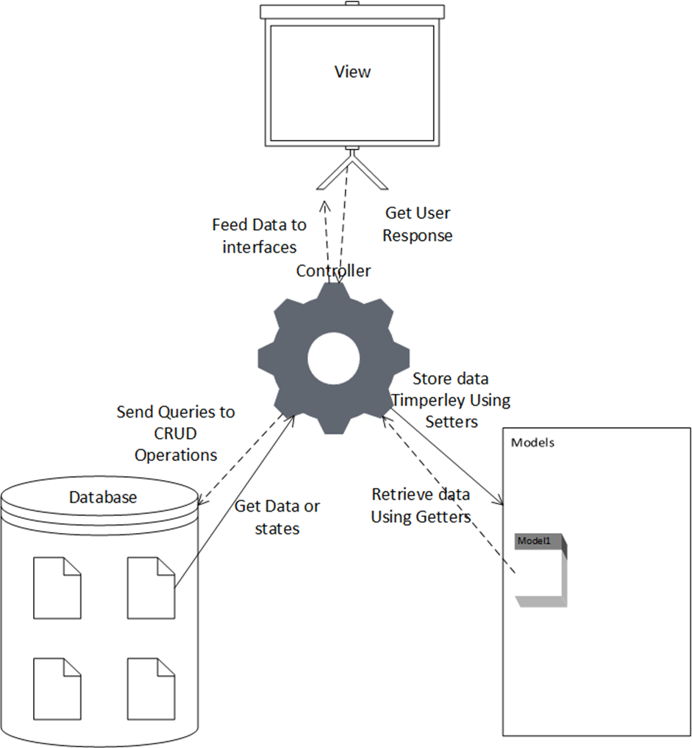
MVC Architecture
Model view Architecture has used to planning and designing the System. So can See Three Different Folder have called model, view and controller.
In view package contains all the user interfaces designed in JavaFX framework as .FXML files.
In the Model package has created java classes for store database data when retrieved and before execute database CRUD operation.
In Controller package contains all the controlling instructions such as connect the database, retrieve data to the data model from data source.
So, User can request particular operation through a user interface and it will be handled by the desired controller. The controller performs operations and used required models to perform database operations

Slide 42
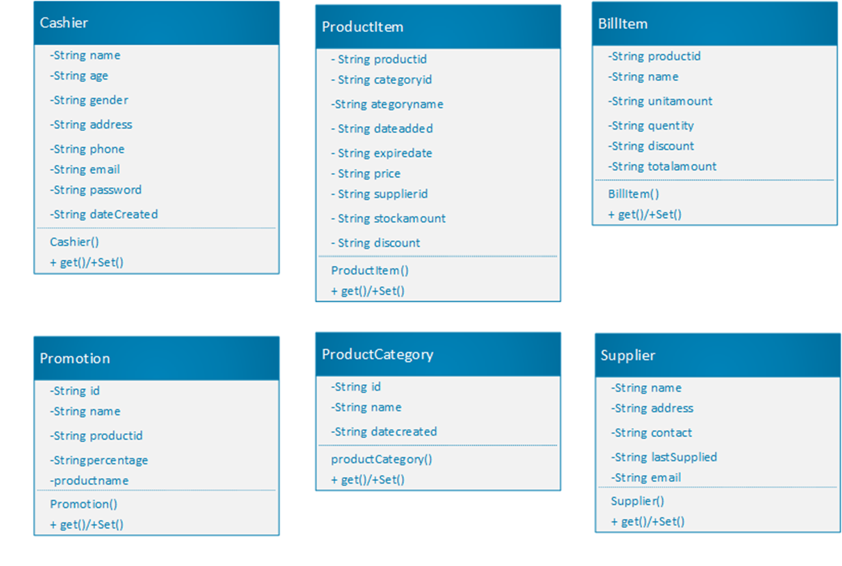
Class Diagrams

Slide 43
Use Case Design

Slide 44
Create a new Bill
01 | Use-Case ID | 001
02 | Use Case Name | Create New Bill
03 | Actor | Cashier / Manager / Admin
04 | Pre-Condition | Cashier privileged user must be logged in Sales items must be loaded in to item table
05 | Main Flow | All uncompleted Previous Bill’s state change to hold Create New Bill (Bill State: new) Get the next Bill number Select the Customer name if exist *(Bill State: Processing)
06 | Alternative Flows | If Customer name does not present in the Customer list, then create a new Customer or assign demo Customer.
07 | Post Condition | Previous bill amounts and data must be cleared System must be ready to get items as input to the bill

Slide 45
Add items to the Bill
01 | Use-Case ID | 002
02 | Use Case Name | Add items to the bill
03 | Actor | Cashier/Manager/Admin
04 | Pre-Condition | Cashier privileged user must be logged in Sales items must be loaded in to item table Created new bill or uncompleted bill must be available to add items (bill state: processing)
05 | Main Flow | Select items from item table to the bill by a. barcode Scanning b. Name Search c. Select items from Item Table Prompt dialog box and ask bought quantity Product id(barcode), name, each price must be received Reduce Available discounts and calculate the total price for the item Product id(barcode), name, qty, each price, discount and total value are displayed at the sale table Update the total bill amount
06 | Alternative Flows | If customer needs to remove item from cart, it can be deleted. If Customer needs to change quantity, it can be updated
07 | Post Condition | All of bought items must be in the bill table Barcode, item name qty, discount and price must be displayed for each row Total bill amount and discount amount must be displayed

Slide 46
Processing Payments
01 | Use-Case ID | 003
02 | Use Case Name | Processing Payments
03 | Actor | Cashier/Manager/Admin
04 | Pre-Condition | Cashier privileged user must be logged in Bought items must be displayed in to sale table Total bill amount, discount amount and payable amount must be displayed.
05 | Main Flow | Cashier asked the payment method by customer If payment method is Card payment, cashier asked customer credit/ Debit card and swipe at the payment gateway device. Process the Payment When Succeeded, Cashier Press the Paid and Print the Bill (Bill State: paid) After Sales Database Update Process must be started
06 | Alternative Flows | If customer ready to pay with cash Cashier receive cash and enter the received amount to the System and press Enter Key System Shows Balance Amount If balance amount has to pay, Cashier settle the Balance Cashier Press the Paid and Print the Bill (Bill State: paid) After Sales Database Update Process must be started
07 | Post Condition | Bill have printed with customer bought items including their price, discounts and total amount, payable amount, balance, and bill number, customer name and date time as well. Bill States has changed to paid

Slide 47
Tools that used to Development

Slide 48
Programming Language
Used Java as the Programming Language to Develop the Point-of-Sale System because of having many advantages when using it. Some of have Below Mentioned
Simple and Easy
Object oriented
Secured
Robust memory management
The platform is independent
Multi-Threaded

Slide 49
Database Management System
MS SQL Server | MySQL
Developed by Microsoft. | Developed by Oracle.
Limited third-party Support because of closed Source | Easy of Use and large number of third-party apps to database handling
Expects a large amount of operational storage space. | Expects less amount of operational storage space.
It enables for stopping query execution. | It doesn’t allow query cancellation mid-way in the process.
Doesn’t block the database while backing up the data. | Blocks the database while backing up the data.
It is not free. | It is open source. It is freely available.
It is a highly secured and doesn’t allow any kind of database file manipulation while running. | It allows database file manipulation while running.
It is available in multiple editions, such as Enterprise, Standard, Web, Workgroup, or Express. | It is available in MySQL Standard Edition, MySQL Enterprise Edition, and MySQL Cluster Grade Edition

Slide 50
User Interface
After Choose Java as the Programing language, Developer has two options to Build user interface
Swing Controllers
traditional AWT Controllers.
But there are many other alternatives frameworks to out there. Among there are several platforms, I selected the JavaFX platform to build clean and attractive user interfaces
Used Scene Builder to build JavaFX interfaces easily and quickly

Slide 51
User Interface Design

Slide 52
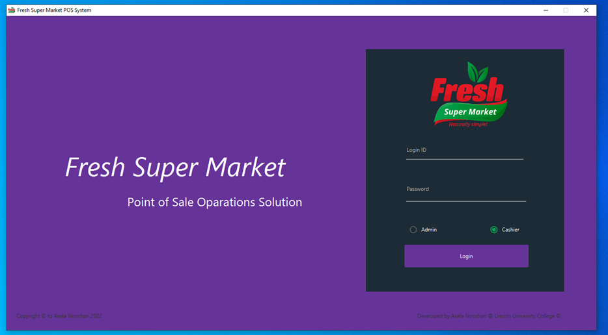
1. Login Interface
There is an authentication process just before let Users to access the pos system.
It used to
prevent unauthorized access
gives permissions to access required features according to user’s privileges.

Slide 53
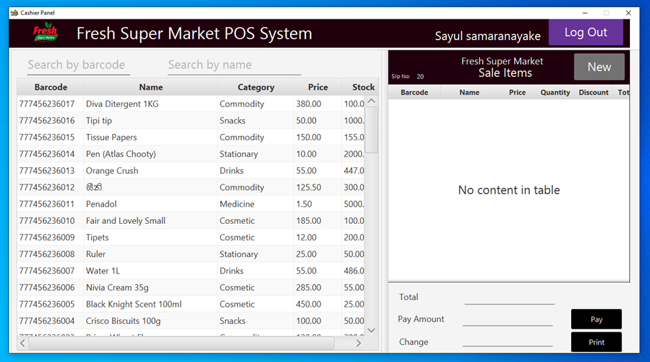
2. Cashier Panel
When a cashier logged in to the system this is the default panel he or she can find.
In the left side table contains all the product item available in the supermarket.
By typing or scanning product barcode, cashier can find customer bought products.
Additionally, cashier can find the required product by typing product name too.
New button will create new bill for new customer
when add the customer bought items those will be added to the right-side panel. And real-time update the bill amount.
After entering items can create bill and after paid it will update the database.

Slide 54
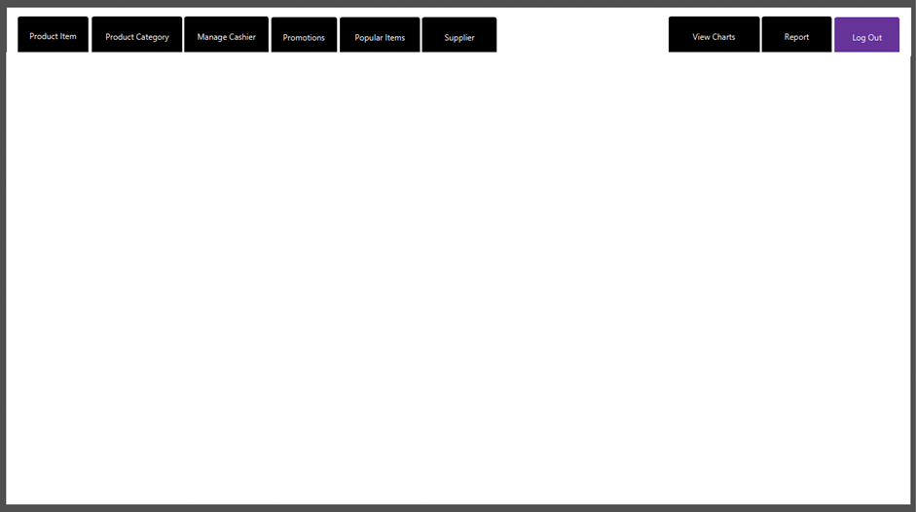
3. Admin Panel
When a user logged as an Admin, he can perform all of admin tasks and those are listed top of the panel.
When User click the navigation item of panel, required JavaFX panel will be loaded to the main admin panel.
Then admin user can perform relevant tasks.

Slide 55
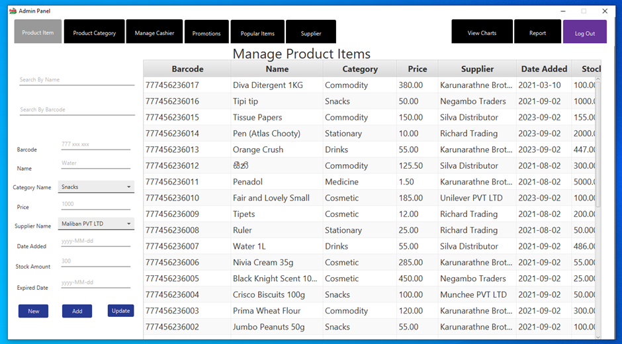
4. Product Items
Product items is the default page to be loaded to the main admin panel when beginning.
In This frame, privileges user Can perform
CRUD Operations in product items
Search and Filter items by its barcode or product name

Slide 56
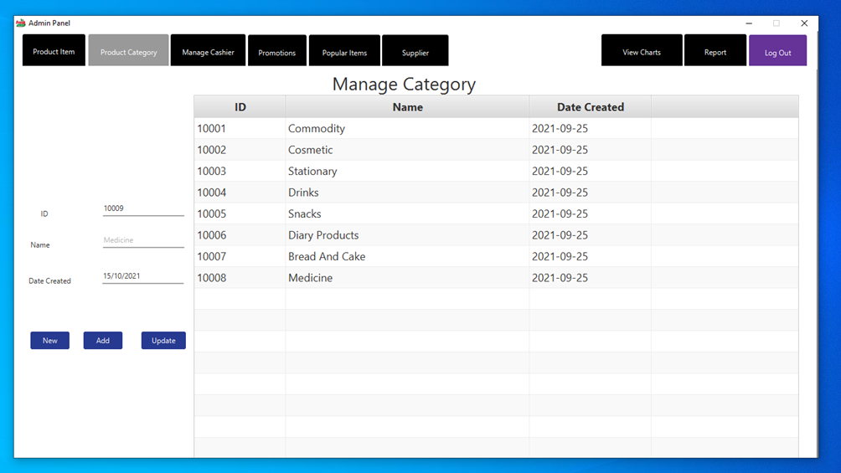
5. Product Category
Admin can create product categories for manage and easily organized to products.
It will be support to generate summarized reports for analyses the sales by categories.
In this panel it supports to create, update and Delete Categories too.

Slide 57
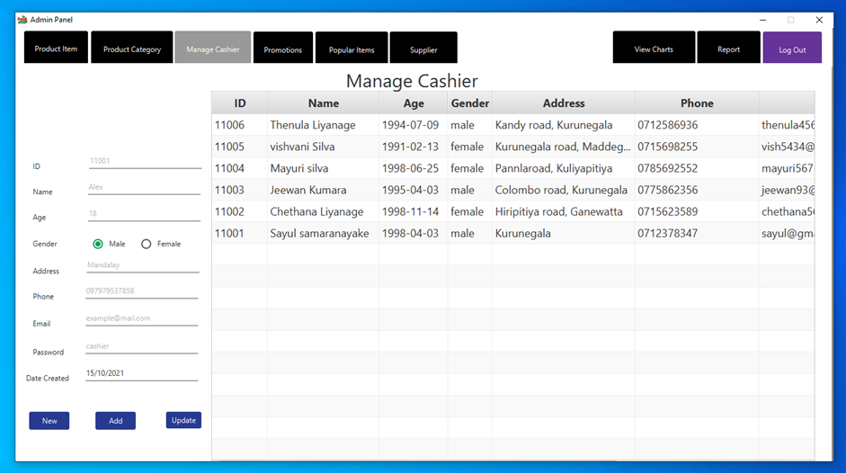
6. Manage Cashiers
Admin can Manage Cashier employees.
He can create cashier users and setup their passwords and update their details.
After creating cashier and assigned password, relevant cashier can log into system as a cashier and can perform POS operations.
As usual This panel also support CRUD operations for Cashiers

Slide 58
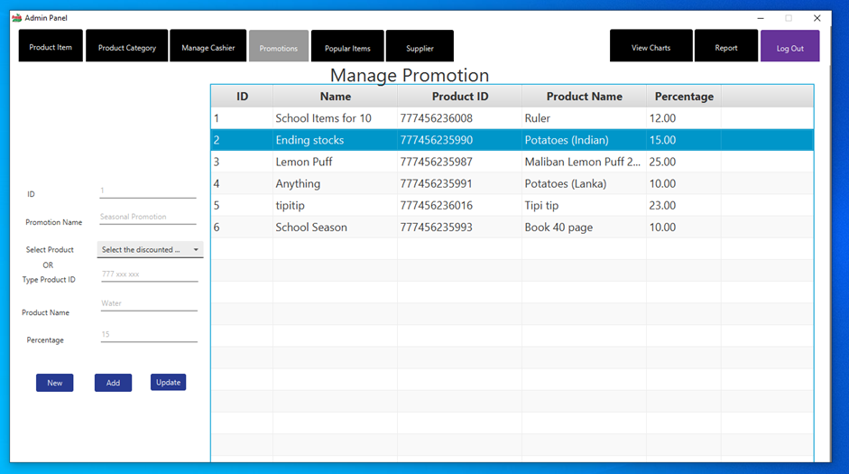
7. Promotional Discounts
Admin can declare discounts for a certain product.
He must mention the percentage of discount and then in POS operation it will be displayed the amount of discount for relevant product.
Admin Can perform CRUD operations as require in here too.

Slide 59
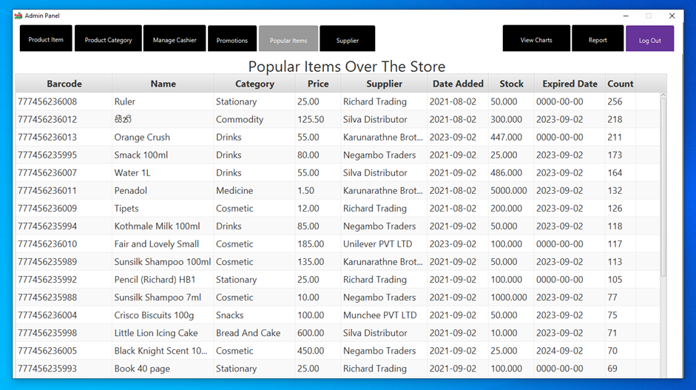
8. Popular items
According to the frequency of buying products, popular items table will be sorted.
So, it will display what are the popular products among the customer within supermarket.

Slide 60
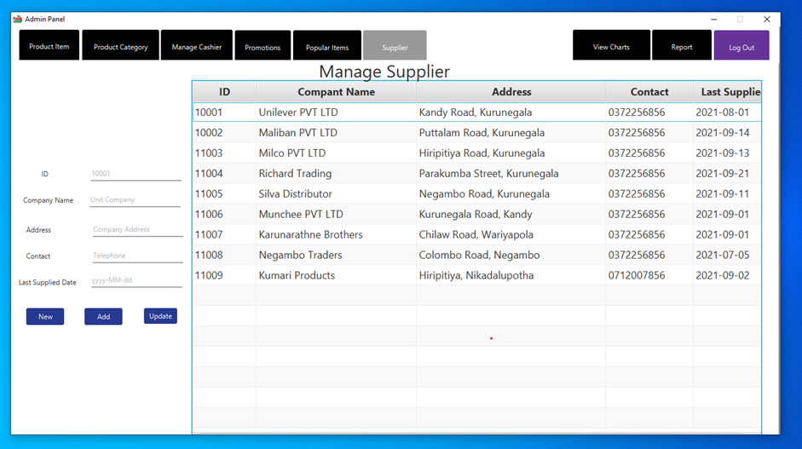
9. Supplier Management
In the Supplier table Admin can manage supplier and change their contacts.
Since the POS system is not perform specialized Inventory management, Admin can perform limited inventory management operations within this system.

Slide 61
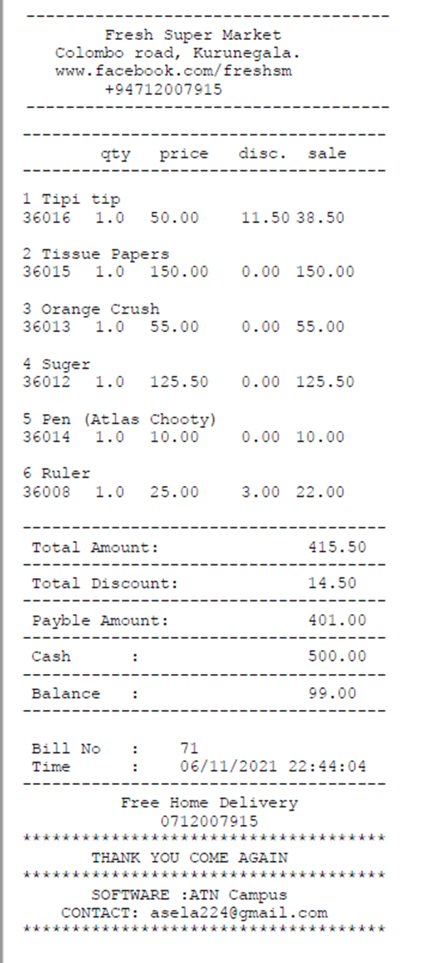
10. Bill Issuing
After payments Customer can obtain detail bill with bought items.
It shows Item name , barcode (product it), qty, each price, discount and price separately and total amount, total discount and payable amount at the bottom.

Slide 62
Implementation

Slide 63
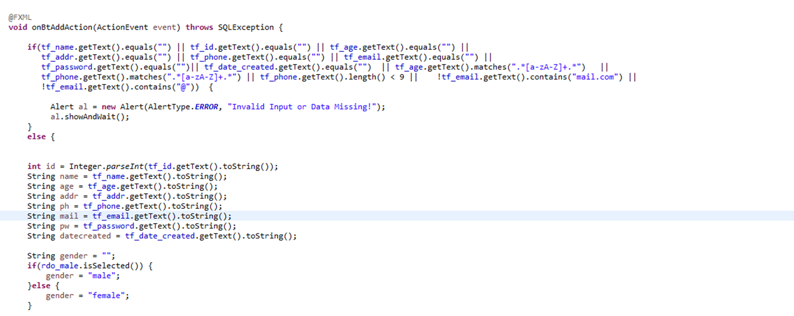
User Input Validation
After Design the User interfaces, then started the Analyzed System implementation.
in implementation process had to consider error and exception free clean system.
So had to pay more attention to validation user inputs to feed database without issues.
So declared data validation process just before Operations to make sure, User has gone through right path with current procedures.

Slide 64
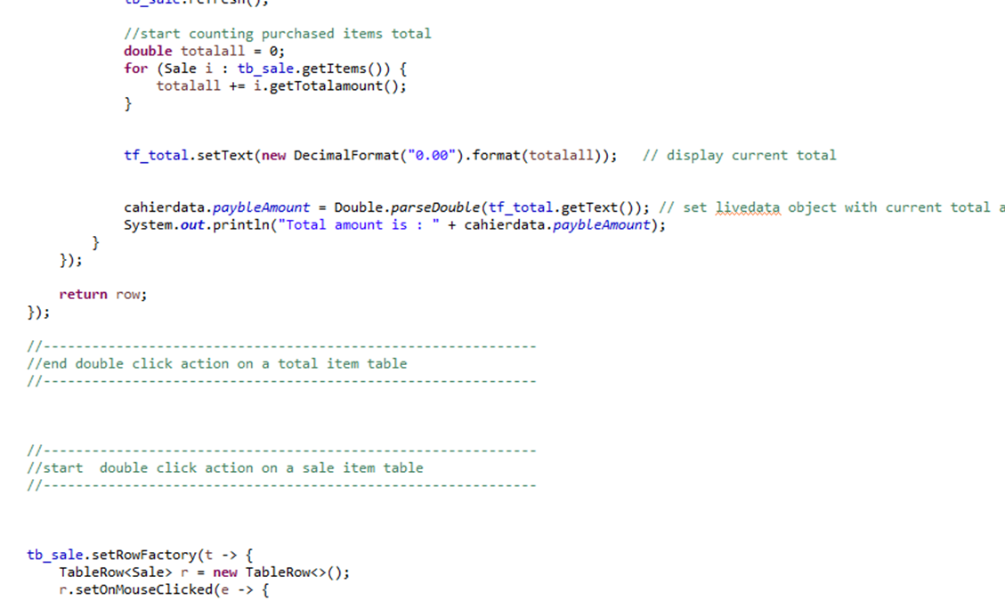
Human Friendly Coding
Coding process is not limited to just run the program well. It has written for understand easily for developers too.
It was very helpful to detect errors and failures and make fix those easily as well.
Has used many comments, like almost code blocks has described with its requirement and how it works.

Slide 65
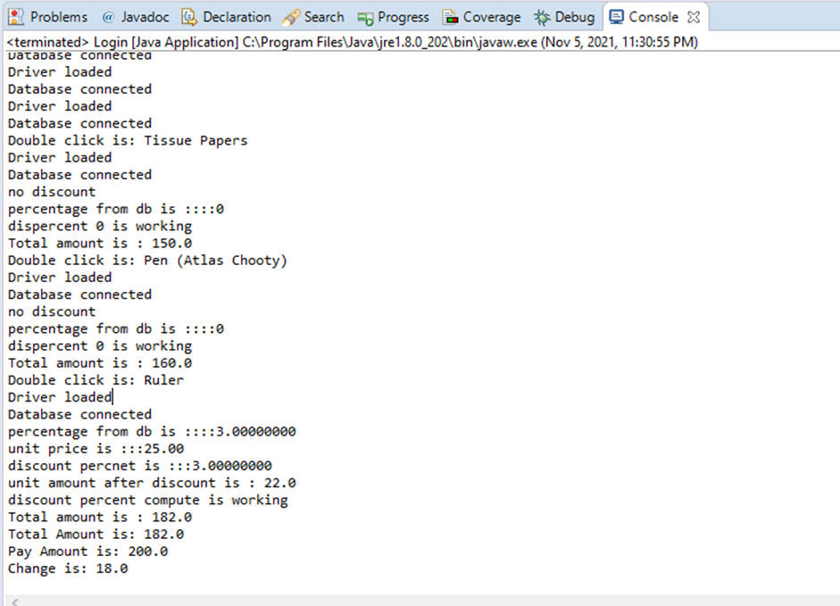
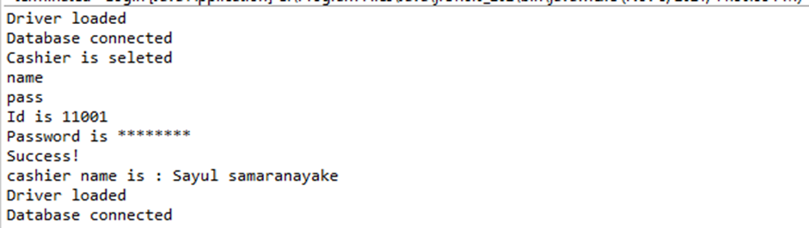
3) Utilized IDE console as a Log viewer
When point of sale solution running on GUI mode, system has used IDE console as a log viewer.
It has displays current states, variable values and user responses as well.
It helped to detect cause and fix those, when throwing exception because of coding mistakes or response handling mistakes.

Slide 66
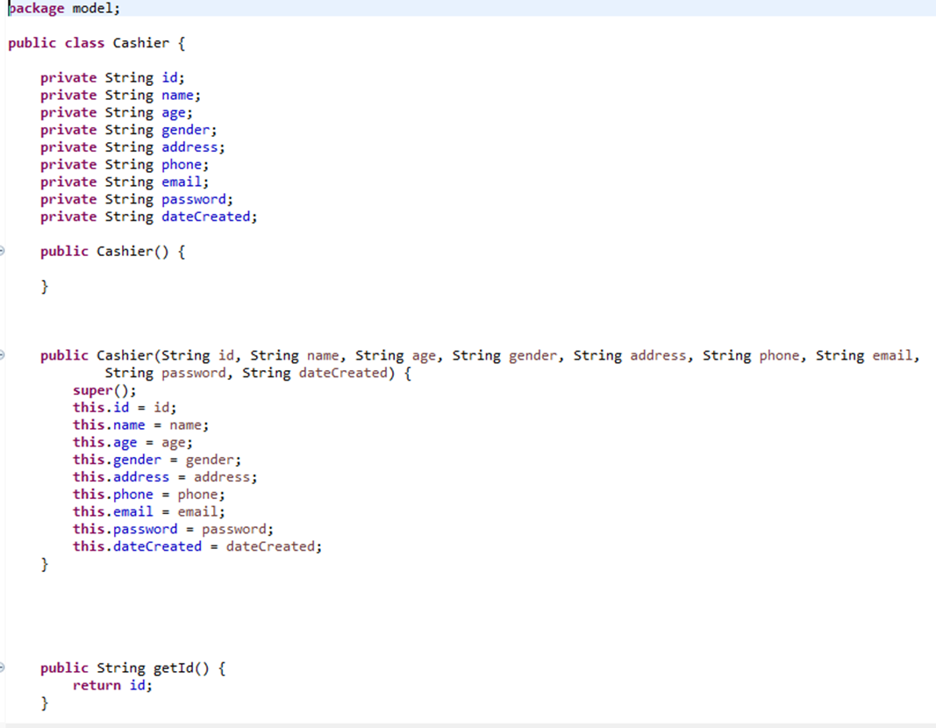
Encapsulation
It has used java encapsulation techniques when creating Model objects to store data.
So declare variables as private and implemented getters and setters to access variable data.
Constructor also overloaded to initialize objects when created.

Slide 67
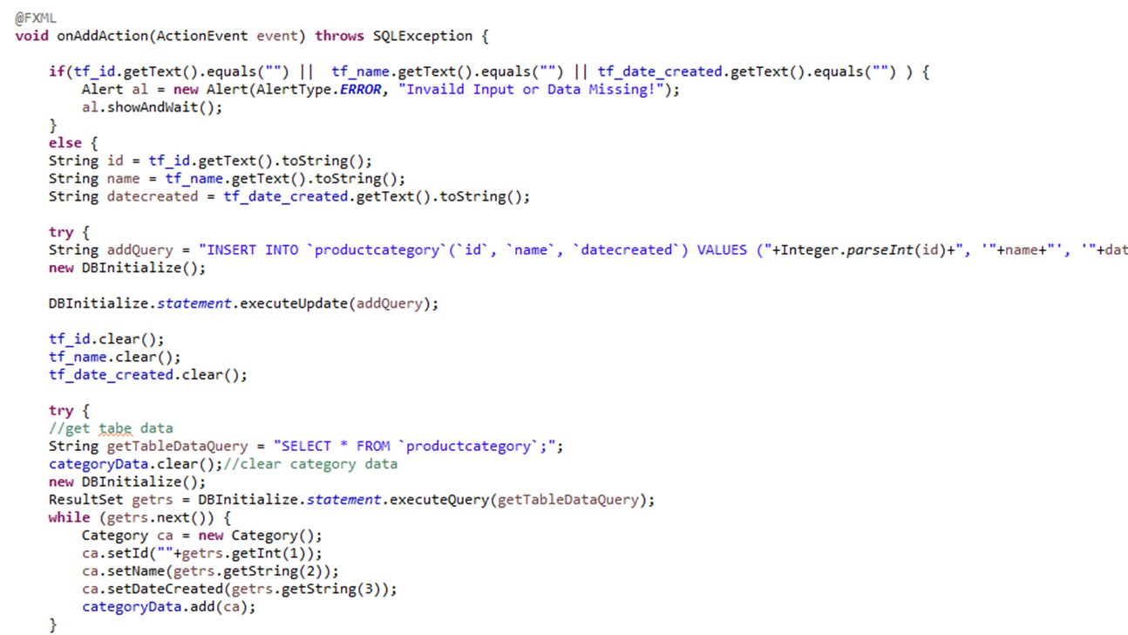
Change Variable Types
In the Database model forced to used relevant data types to store data.
But in the system, it has to change the type as required. When require to data represent in text Fields, its needs to convert them as Strings. When need to do calculation, those are converted to numeric types.
And also when execute database query, it need to convert as relevant variable types

Slide 68
Test Plan

Slide 69
Testing Methodologies
White Box Testing
Black Box Testing
User Acceptance Testing

Slide 70
White Box Testing
Testing is being done while development and coding is done.
Errors will be identified at the moment where development happens and fixed them at the same time.
This is very effective way and defects can be fixed without going to the Testing phase.
It is a method of testing software that tests internal structures and working of an application.

Slide 71
Black Box Testing
Testing which will be done by examines the functionality of an application without monitoring the internal structures of the system.
This testing will be done without looking at internal code structure, implement details and knowledge of internal paths.

Slide 72
Usability and User Acceptance
Testing which will be done by the user. User will give feedback about the system after done testing by the user. So, the things which they are mentioning and errors need to be fixed after the user Acceptance testing.
To get what are the actual needs and to get an idea how user will interact with system one of the methods can be used is Questioners can.
By giving some set of simple questions with answers to choose able to identify the way how user expected the system should behave and what type of computer knowledge they have.
And also, what kind of people are going to interact with the system. Following is a part of Questioner used for the Point-of-Sale system.

Slide 73
Testing

Slide 74

Testing Login View
Test Scenario | Test cases | Status (Pass/o n hold/Fail) | Comments
Test Login View and its Basic Functions | Test case 1: Check password not display when typing | Pass
 | Test Case 2: Check user must enter valid user name and password as well as the role for login | Pass
 | Test Case 3: Check Load relevant views according to the user role when logged in | Pass
 | Test Case 4: Check invalid login credentials are not accepting and gives an error | Pass

Slide 75
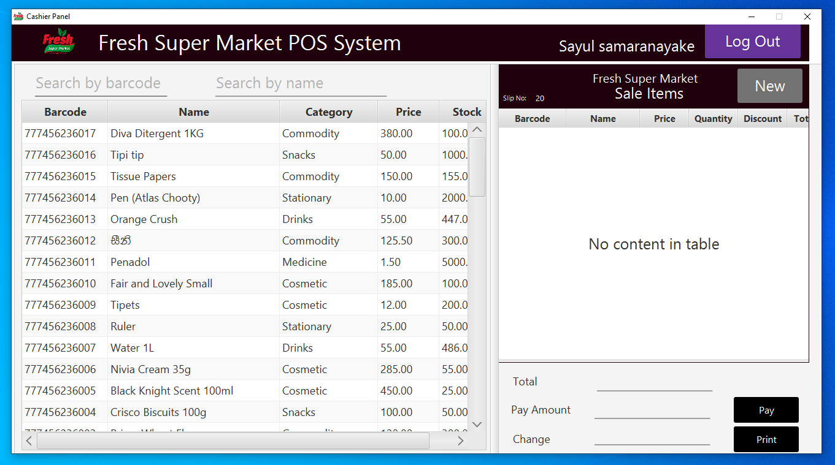
Testing POS Operations
Test Scenario | Test cases | Status (Pass/o n hold/Fail) | Comments
Test POS View, operations and its Functions | Test case 1: Check item tables has loaded product items correctly | Pass
 | Test Case 2: Check barcode and Item name search filter works correctly | Pass
 | Test Case 3: Check cashier name displayed in top right corner | Pass
 | Test Case 4: Check next slip number displayed top of the sale item table | Pass
 | Test Case 5: Check selected items added to sale item table | Pass
 | Test Case 6: Check display each price, quantity, discount and price correctly | Fail | When Update Quantity Discount percentage changing (Fixed)
 | Test Case 7: Check cashier can change quantity and then update price according to quantity | Pass
 | Test Case 8: Check Total amount displays correctly | Pass
 | Test Case 9: Check Display balance if available when input paid amount and hit enter | Pass
 | Test Case 10: Check Display balance if available when input paid amount and hit enter | Pass
 | Test Case 11: Check update inventory and sale records when press pay button | Pass
 | Test Case 12: Prompt to print the bill when press print | Pass

Slide 76
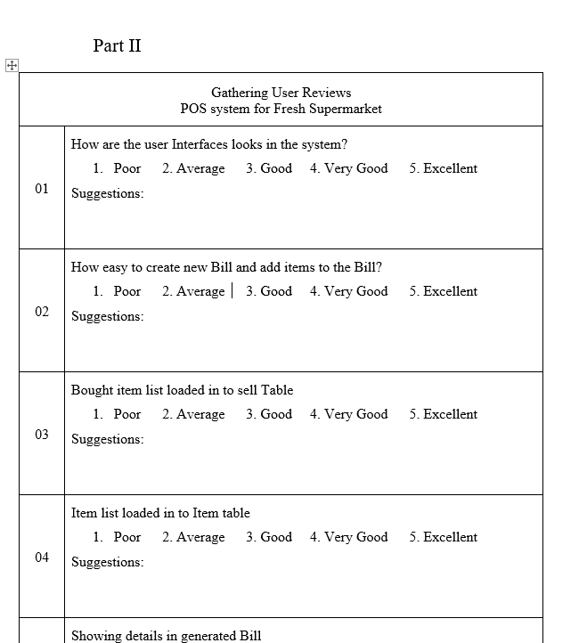
User Acceptance Questioner
Evaluation of Point Of Sale system
Fresh Supermarket
Part I
How many experiences you have as an employee?
Less than 2 years
Greater than 2 years
Greater than 5 years
Your knowledge about handling computer Software
Basic
Average
Advance
Your Knowledge about Payroll system
Basic
Average
Advance
How much user Friendly the POS system Software
Bad
Good
Excellent
Is the System is satisfied with your needs
Yes
No
Need to do modifications to this system.
Yes
No
(If needed please mentions your suggestions on No10 at the Part 2 )

Slide 77
Future Upgrades

Slide 78
Security
Fresh Super market Point of Sale System need to be updated in Security essentials. Sensitive data such as Employee Personal data has stored as plain text. Anyone has accessed the Database server can retrieve that data or alter as well. Hope to store data as cyphertext instead plain text in future versions.
So currently system database not used to store high privileges users such as Manager and Admin. Those login data have stored in a Variable. After implement cryptography those sensitive data can be stored in Database as cyphertext.

Slide 79
System Logs
Even IDE console used as a demo log viewer it can’t b used in real environment. Its can available only for developers. So Hope to Implement log file in later versions to Check system behaviors an get troubleshooting tips when system failure.

Slide 80
Reports & Charts
Hopefully designed areas to implements additional decision-making support reports and charts to visualize company states.

Slide 81
Learning Outcomes

Slide 82
What I Have Learnt
Before complete this kind of project, I was thinking Coding/implement part is the harder part in a software development as well as System Analyzing. But End of this project I have got a little experience how to actual project works.
So, I figured out Implementation part is not so hard, If We have a Proper analyzed system to Develop. And Why We must allocate reasonable time period to analyses the System.
Then Keep everything in a Document is easier than keep everything is in mind.

Slide 83
What I Have Learnt
I had to learn about following technologies to complete this project
Java FX
MVC Architecture
Then I have improved my skill in following areas
Flat UI User Interface Design
JDBC Connectivity Exceptions
Database Concepts and MySQL
Easy to read and understand Coding to Programmers /Developers

Slide 84
Thank You …………..

